Slide 1
IDTM set-up
Step-by-step guide

Slide 2
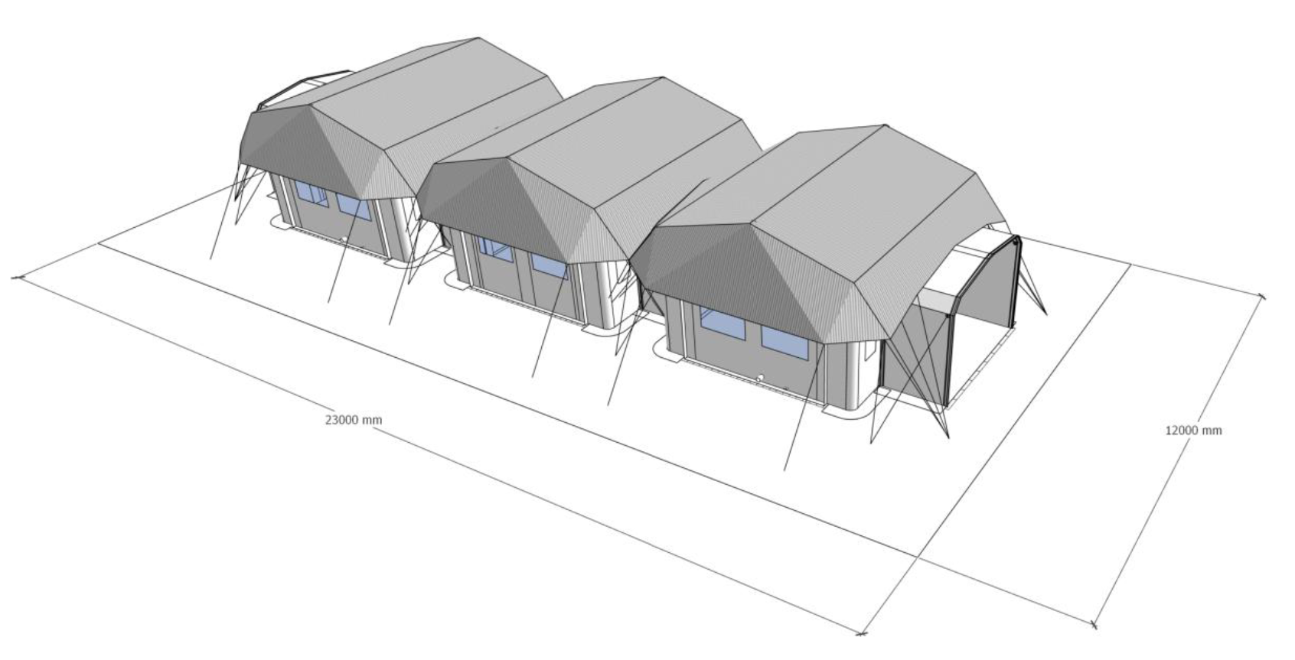
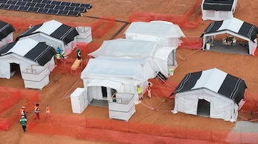
IDTM main components
Main components
Patients’ pods
Staff pod
Vestibule
Hard flooring
Shadowing net
Portals (different types of portals)
5
3
5
1
5
6
3
2
6
3
1
6
3
4

Slide 3
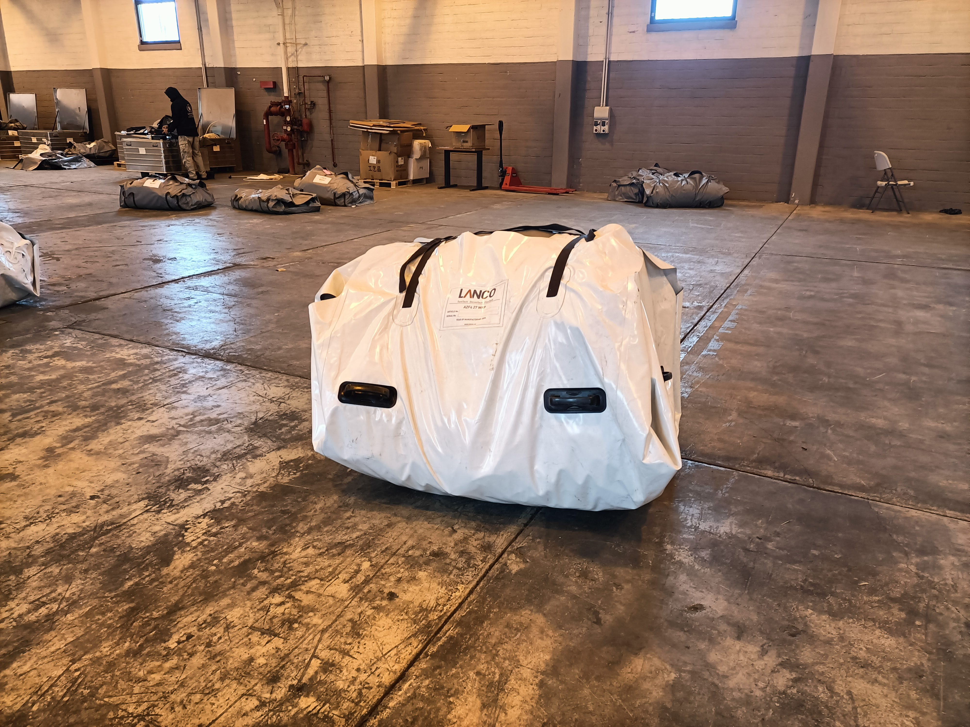
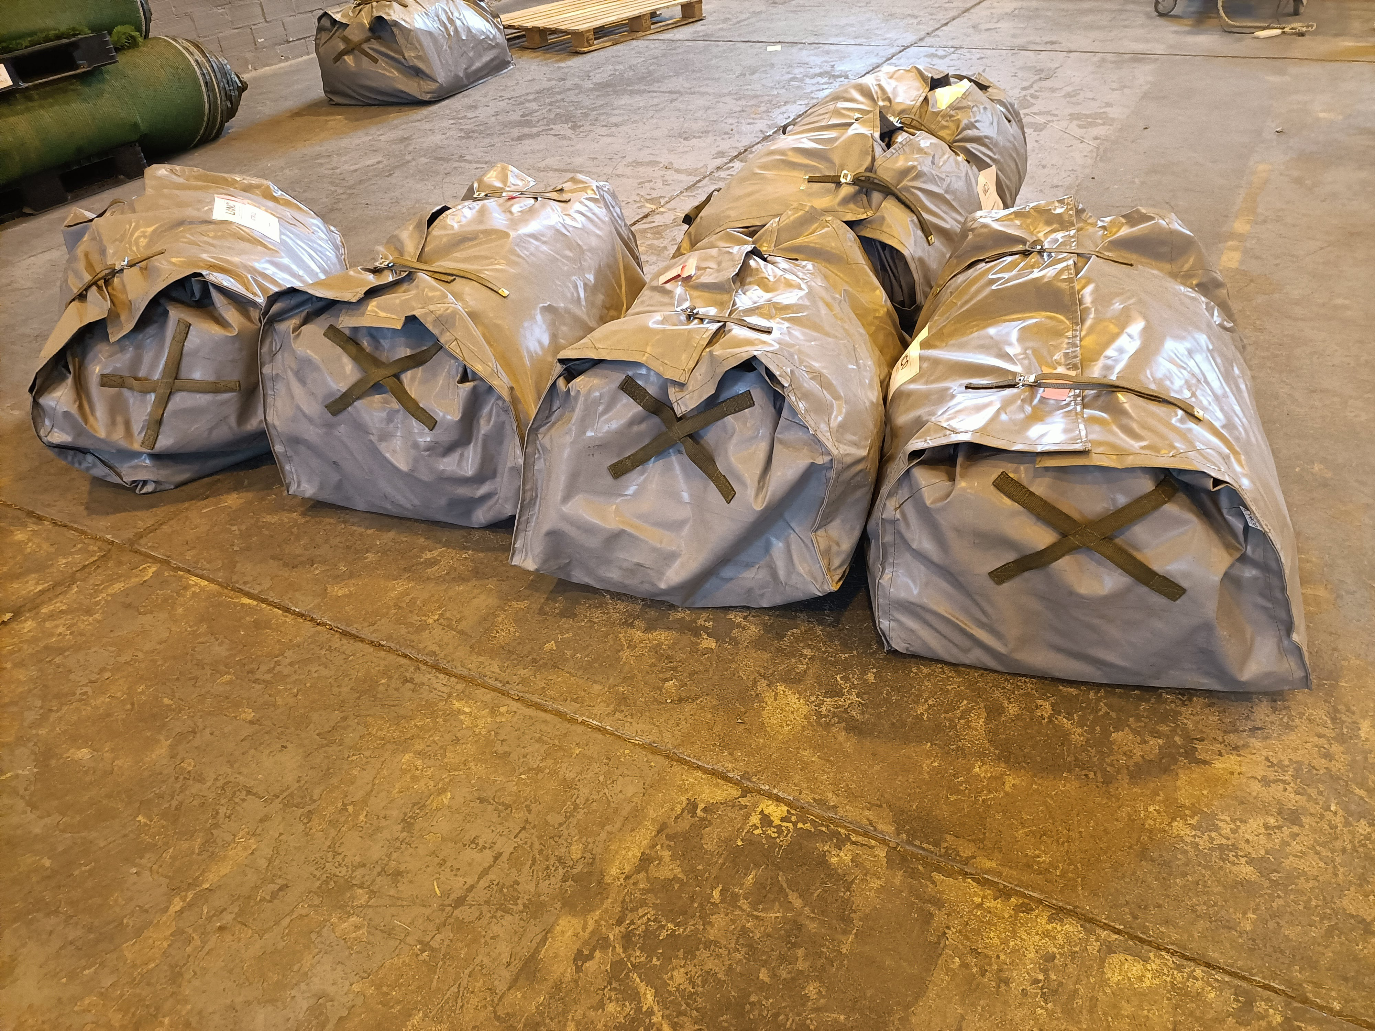
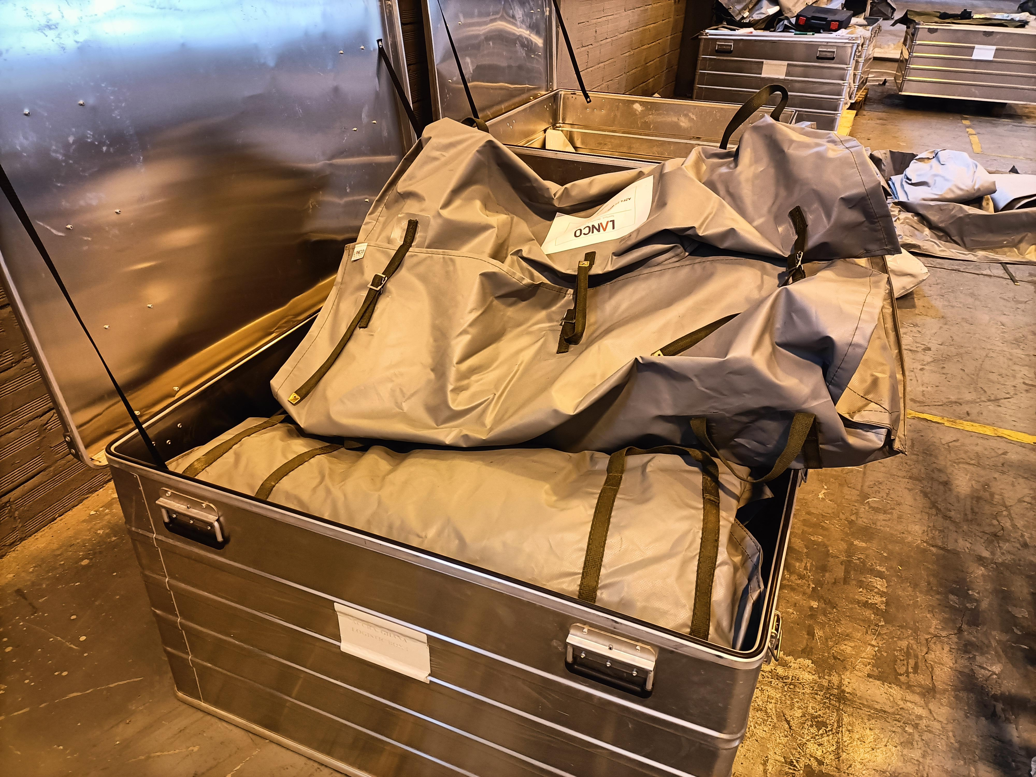
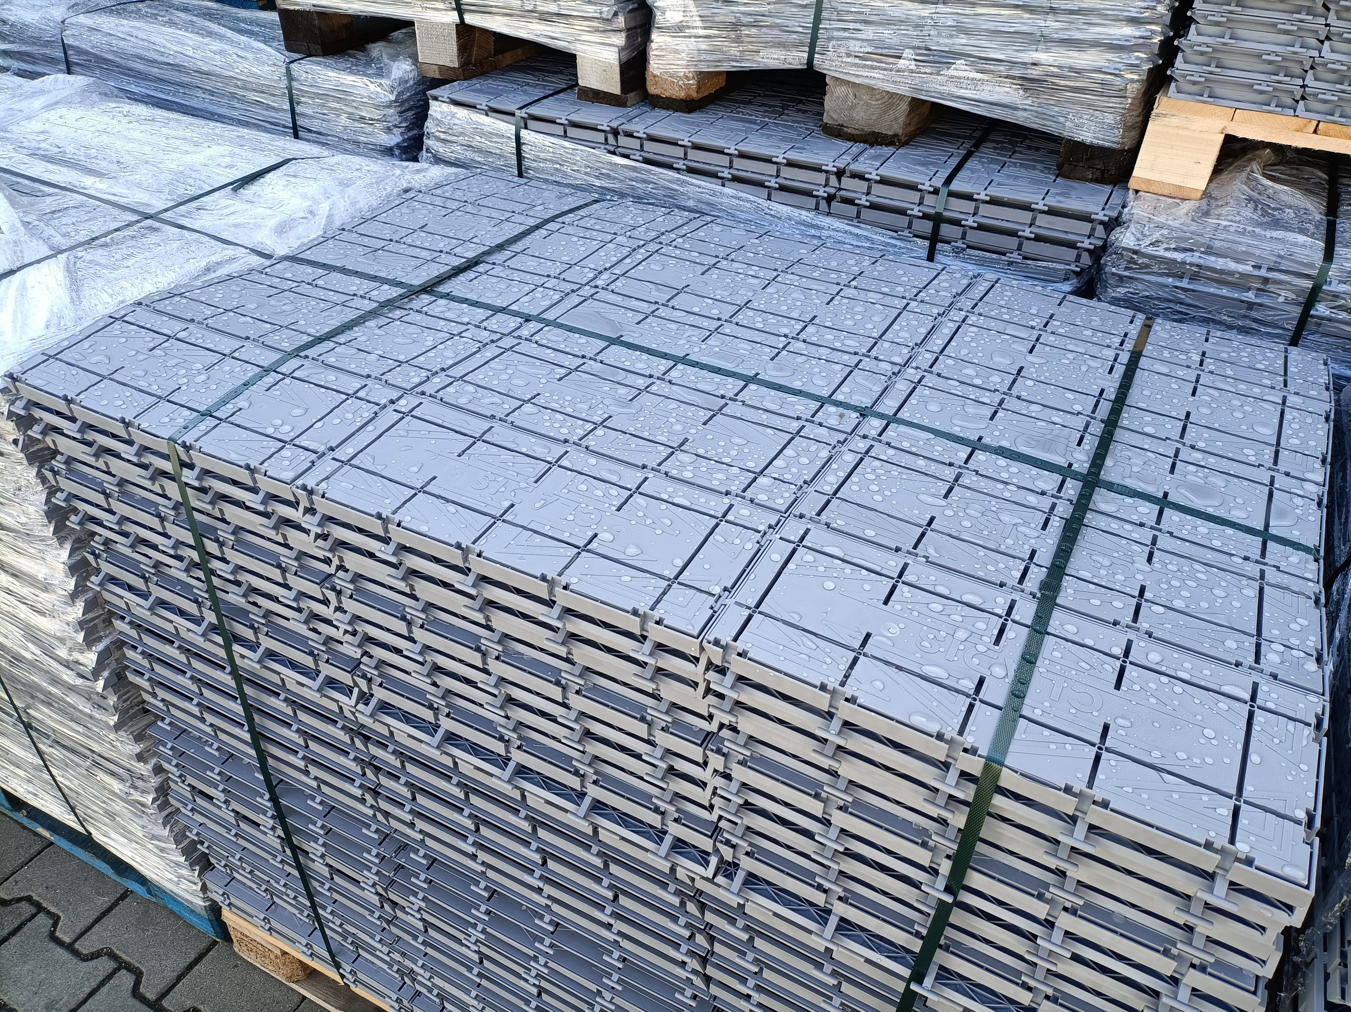
IDTM packaging
X 3
Pod structure, inflatable + inner liner pre-installed.
Transported on 1 pallet.
8 people to move it
Bags
Vestibules, panels, shadow nets are packed in bags.
2-4 people to move them
Aluminium boxes
Contain bags with IDTM components, electric kit, installation kit, etc.
Tiles
1 pallet of hard flooring tiles per each pod

Slide 4
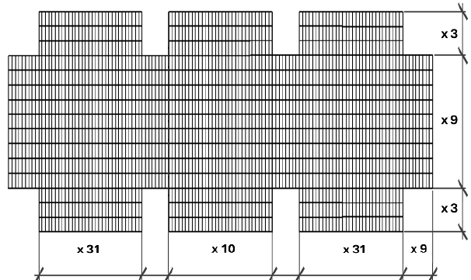
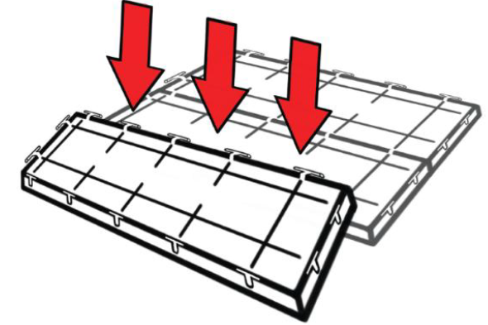
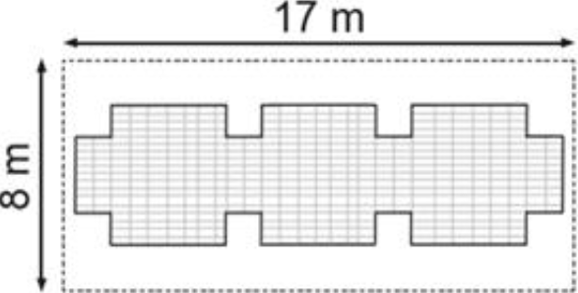
Step 1
Install the hard flooring according to the layout:
Count the number of tiles needed
Male-female connection

Slide 5
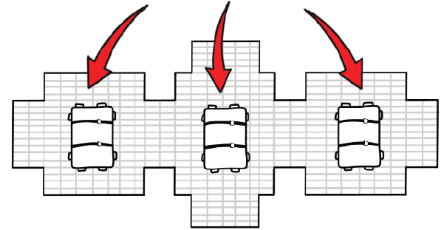
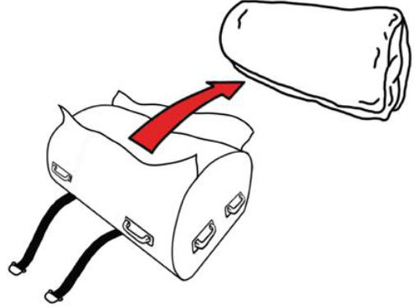
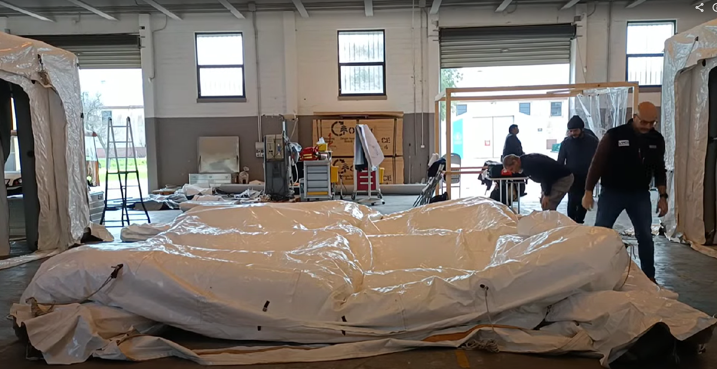
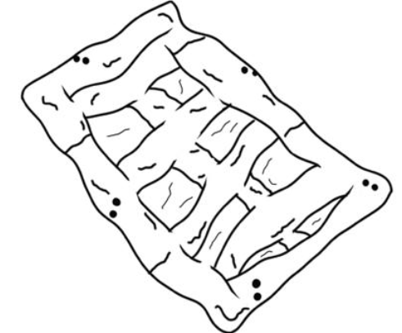
Step 2
Place the package of the pod over the hard flooring, in the center
Open the bag
Roll out the tents
Unfold the tents and spread them pulling the four corner loops

Slide 6
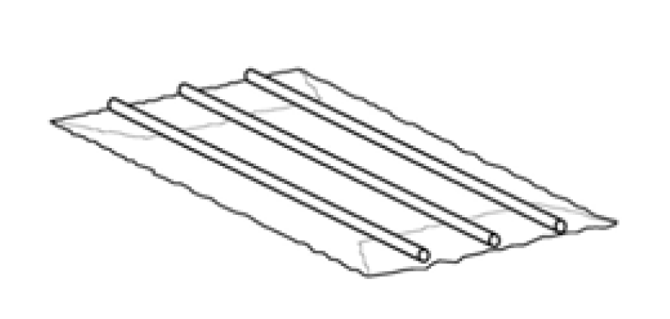
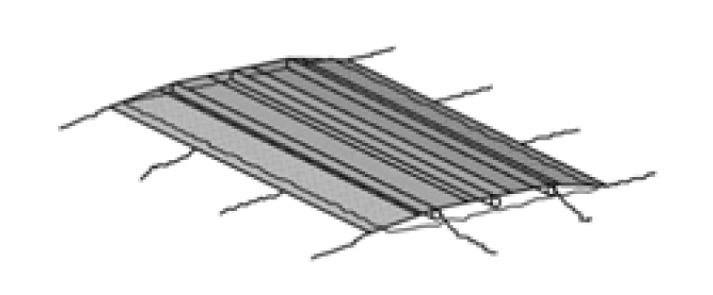
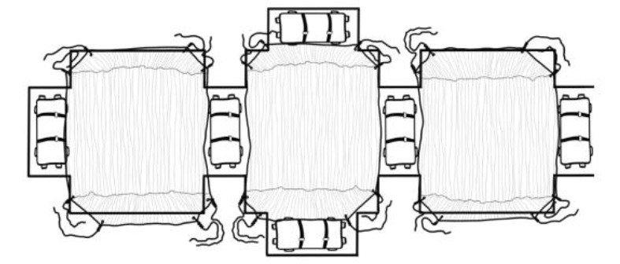
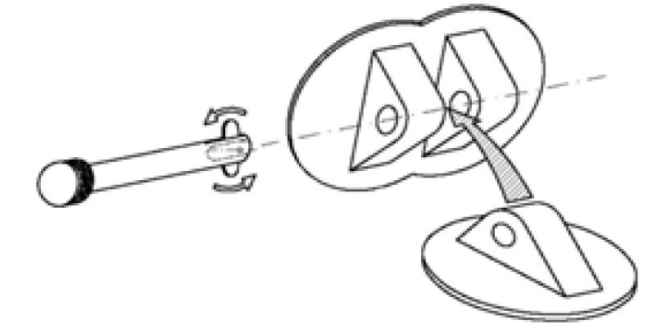
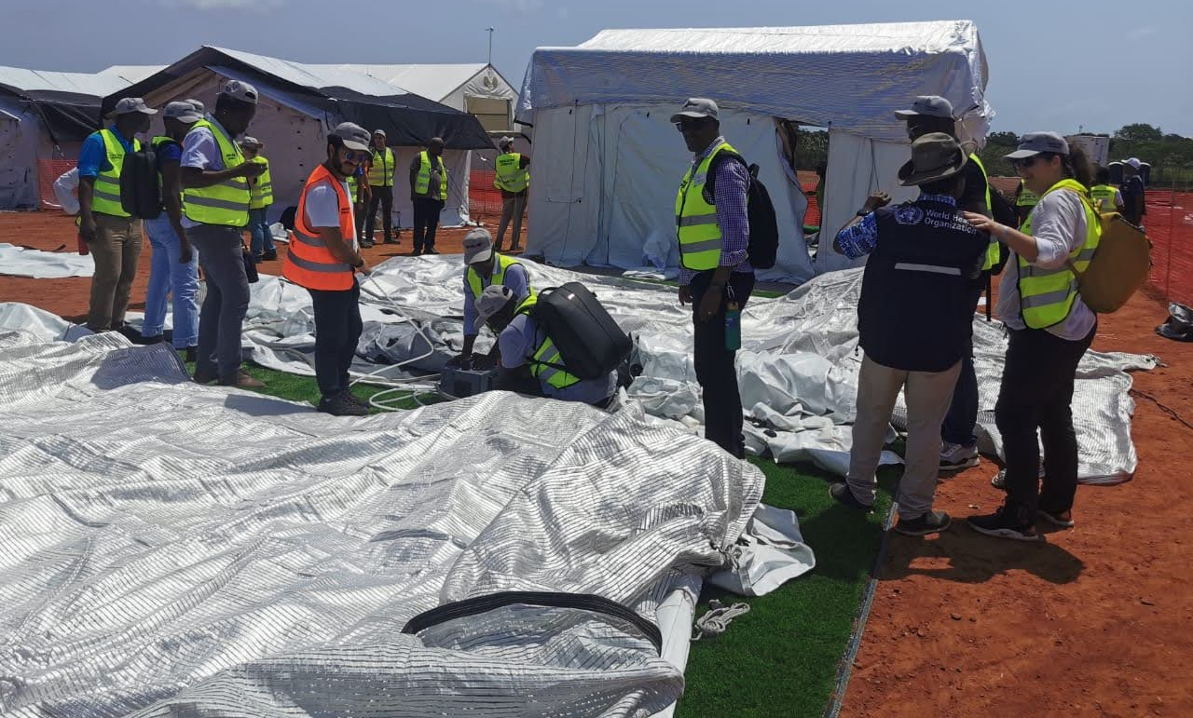
Step 3
Install the shadow net on top of the tent:
Open the pneumatic spacers on the roof
Fix them lengthwise on the tent using the couplings located at the eaves and ridge of the tent
Inflate the pneumatic spacers until the operating pressure of 0,3 bar is reached
Spread out the 3 sun shadowing nets over tent

Slide 7
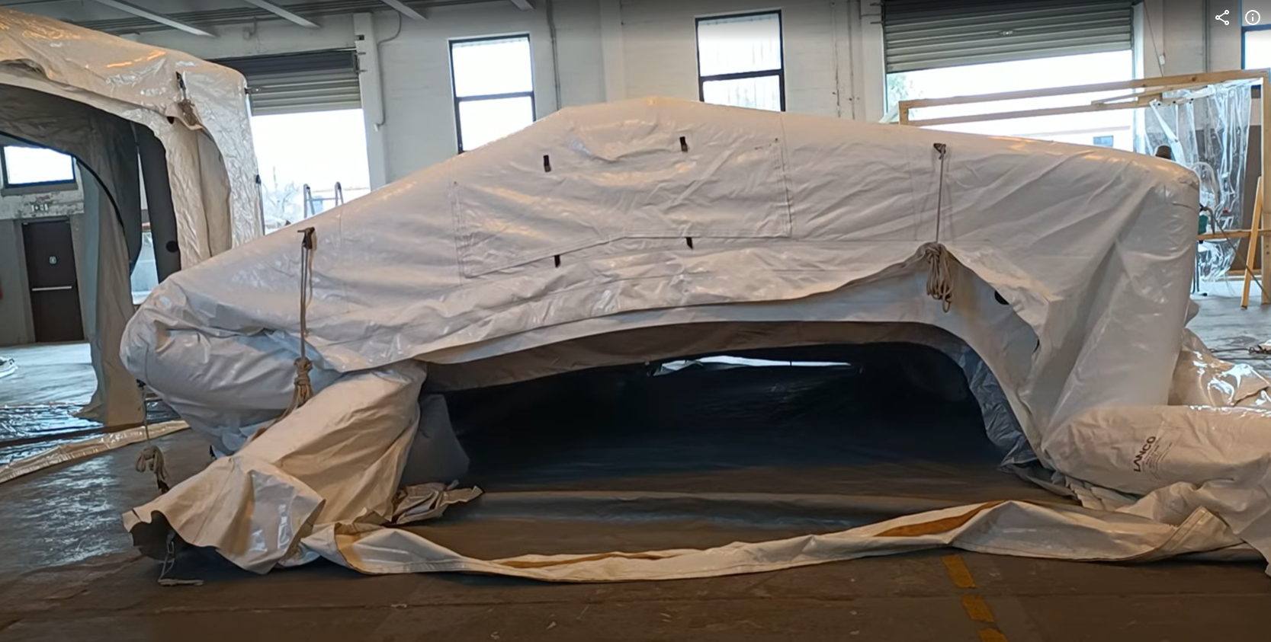
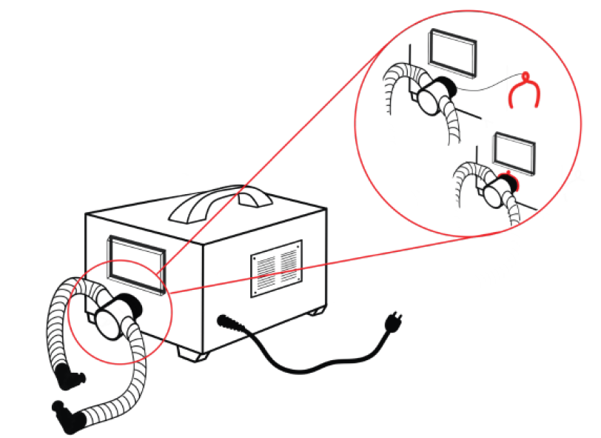
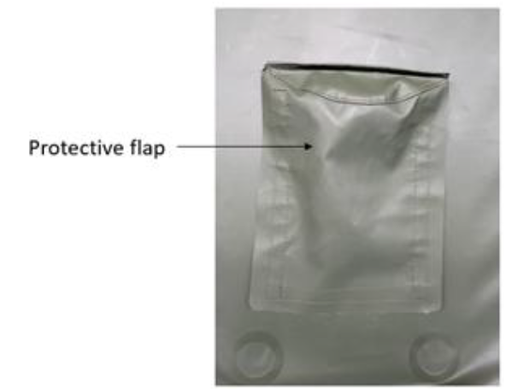
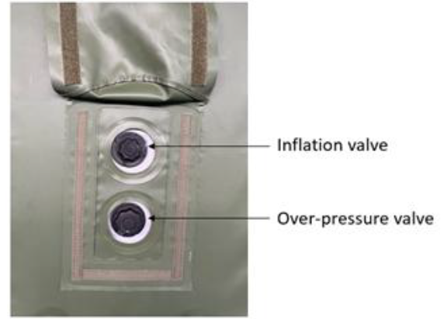
Step 4
Locate the inflation valves on the lower end of each pneumatic arch, on one side of the tent
Each pneumatic arch is fitted with an inflation valve and all valves need to be connected to the electric inflator for simultaneous inflation

Slide 8
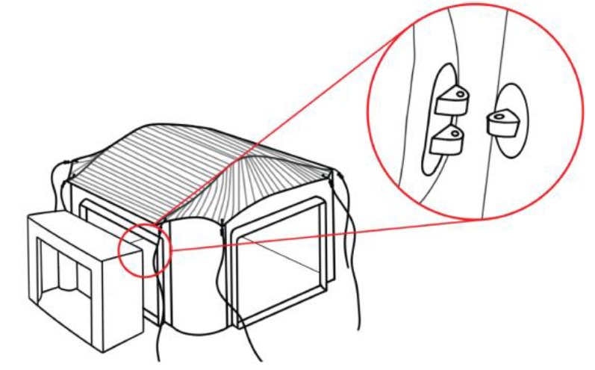
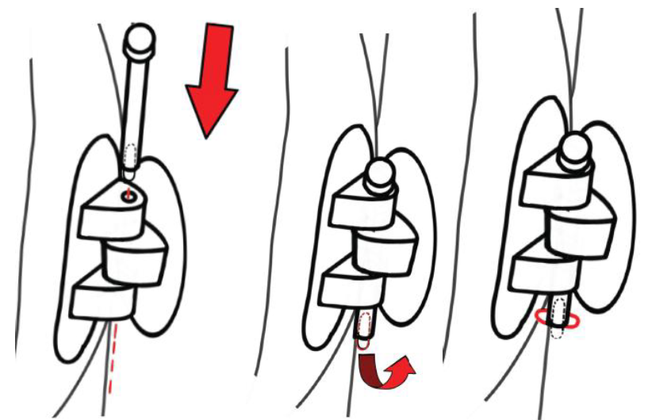
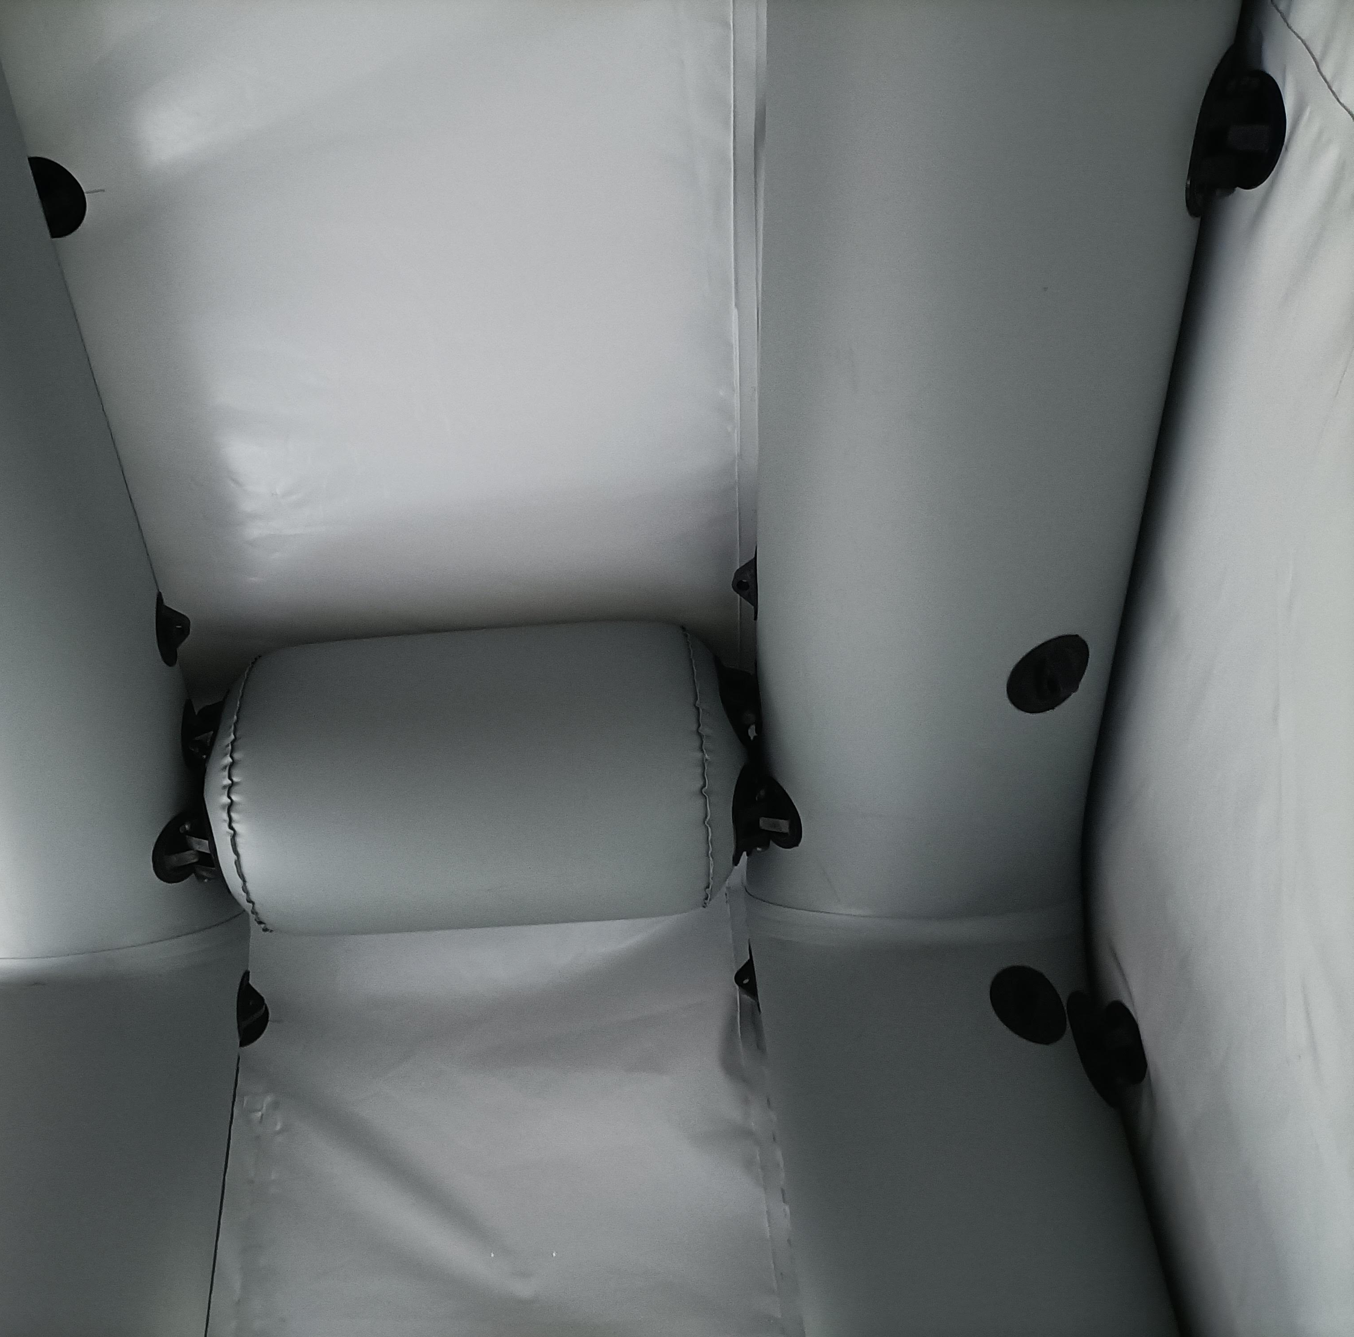
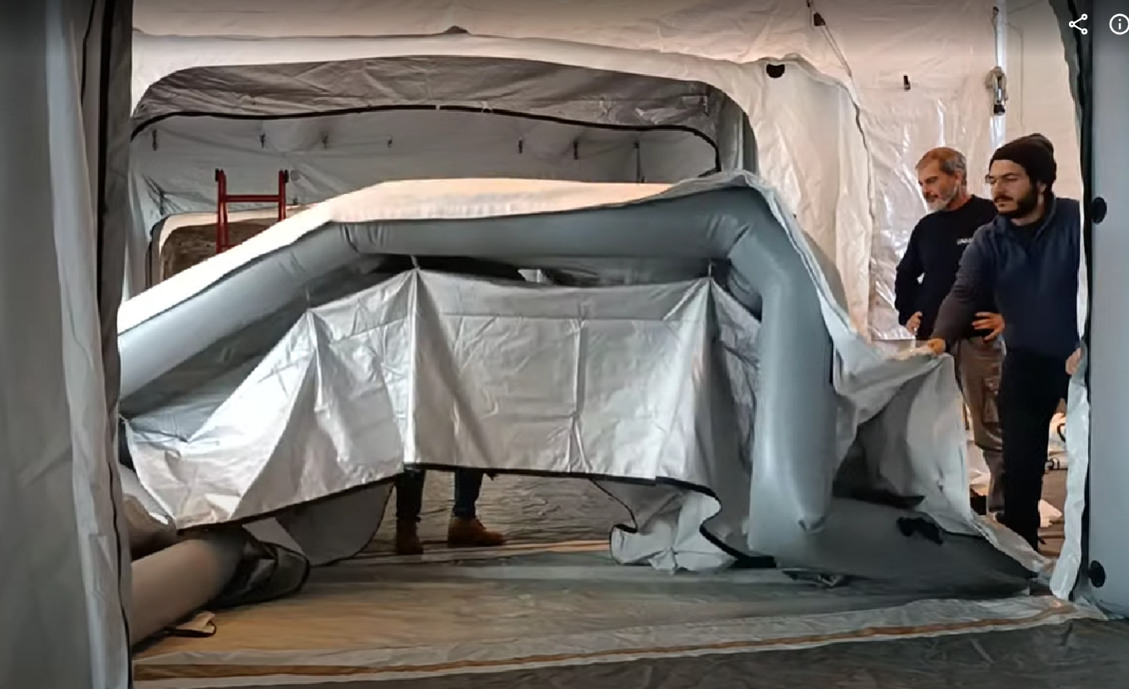
Step 5
Installation of the vestibules:
Spread the 4 vestibules out by pulling on the four corner loops.
Inflate the vestibules
Connect the vestibules to the pods

Slide 9
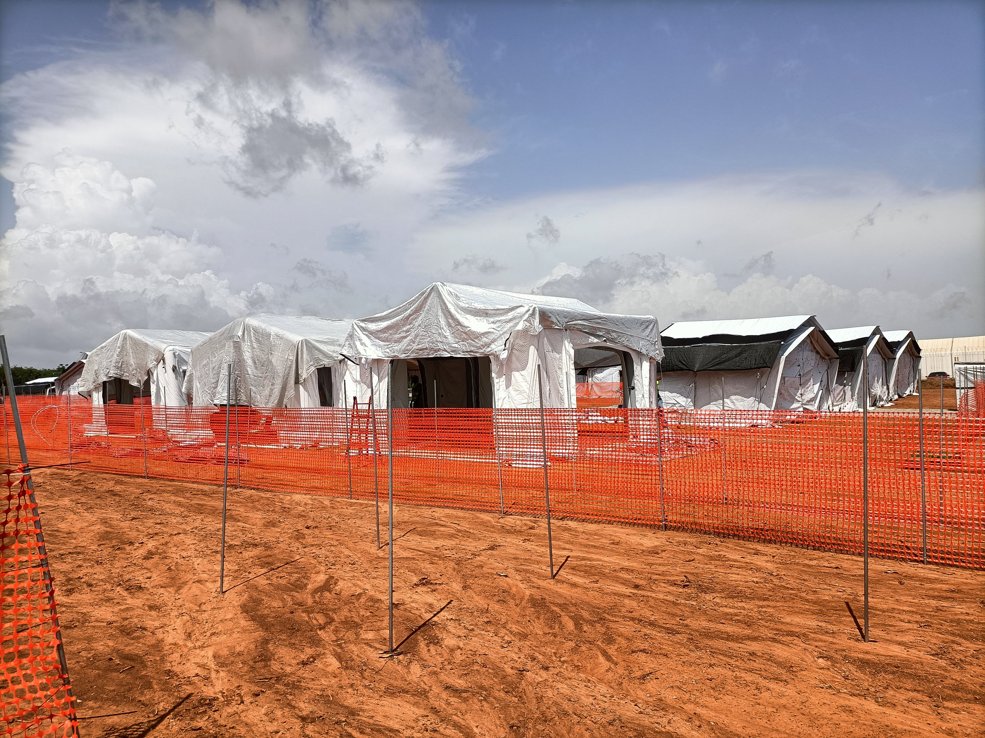
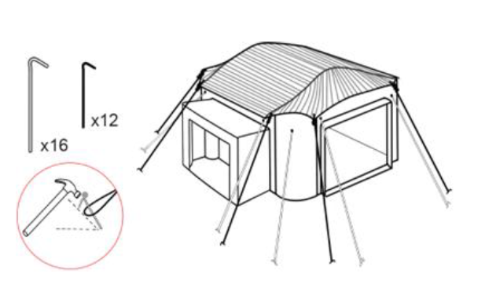
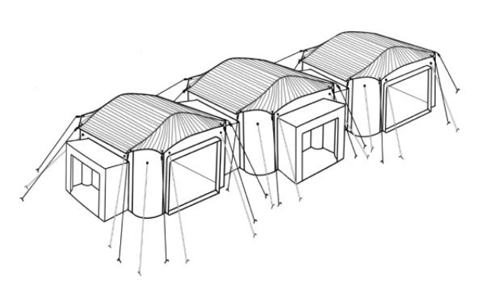
Step 6
Fix the structure to the ground:
Use the small 30 cm T-pegs to fasten the groundsheet loop ropes to the ground. We recommend rolling the rope around the peg for optimal tension.
Use the long 50 cm T-pegs to fasten the guy ropes to the ground. We recommend inserting the 50 cm T-pegs at approximately 1,5m from the tent
Adjust the tension of the guy ropes using the cleat tensioner.

Slide 10
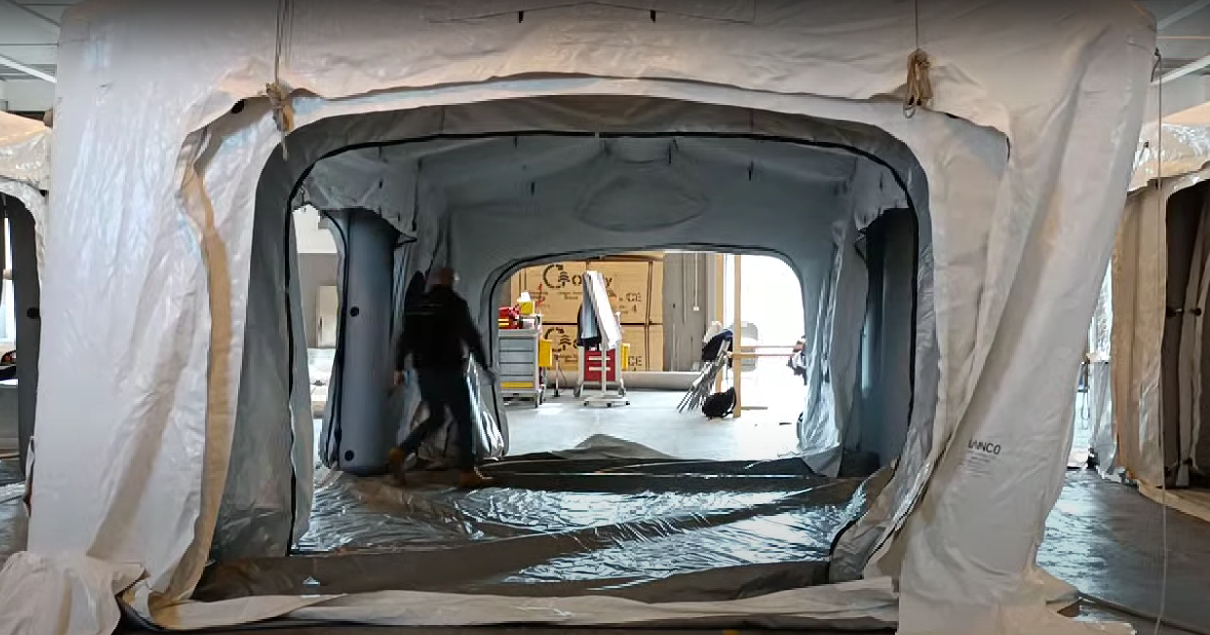
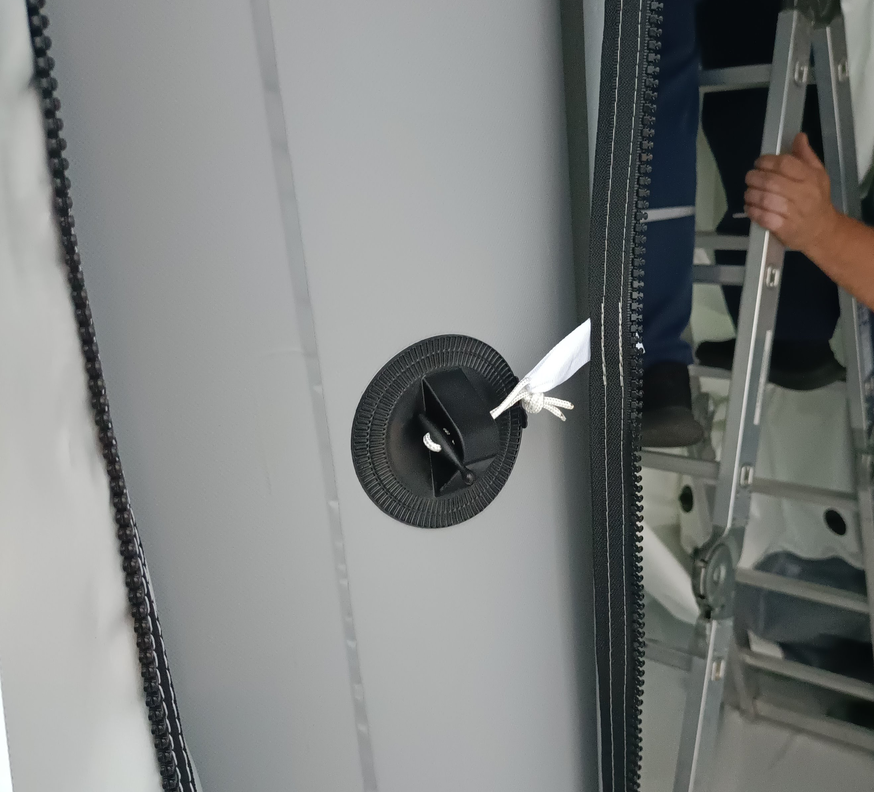
Step 7
Installation of the inner liner:
Inner liner is pre-installed in the three pods only on the top
Connect the inner liner with the main IDTM structure
Starting from one side of the tent, insert the toggle buttons inside the plastic studs of the outer frame.

Slide 11
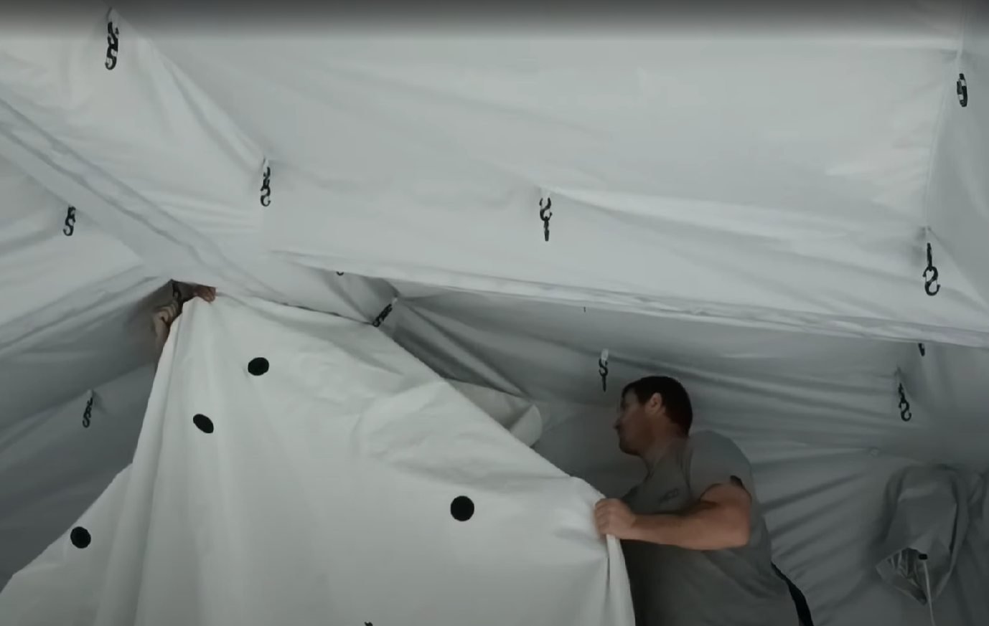
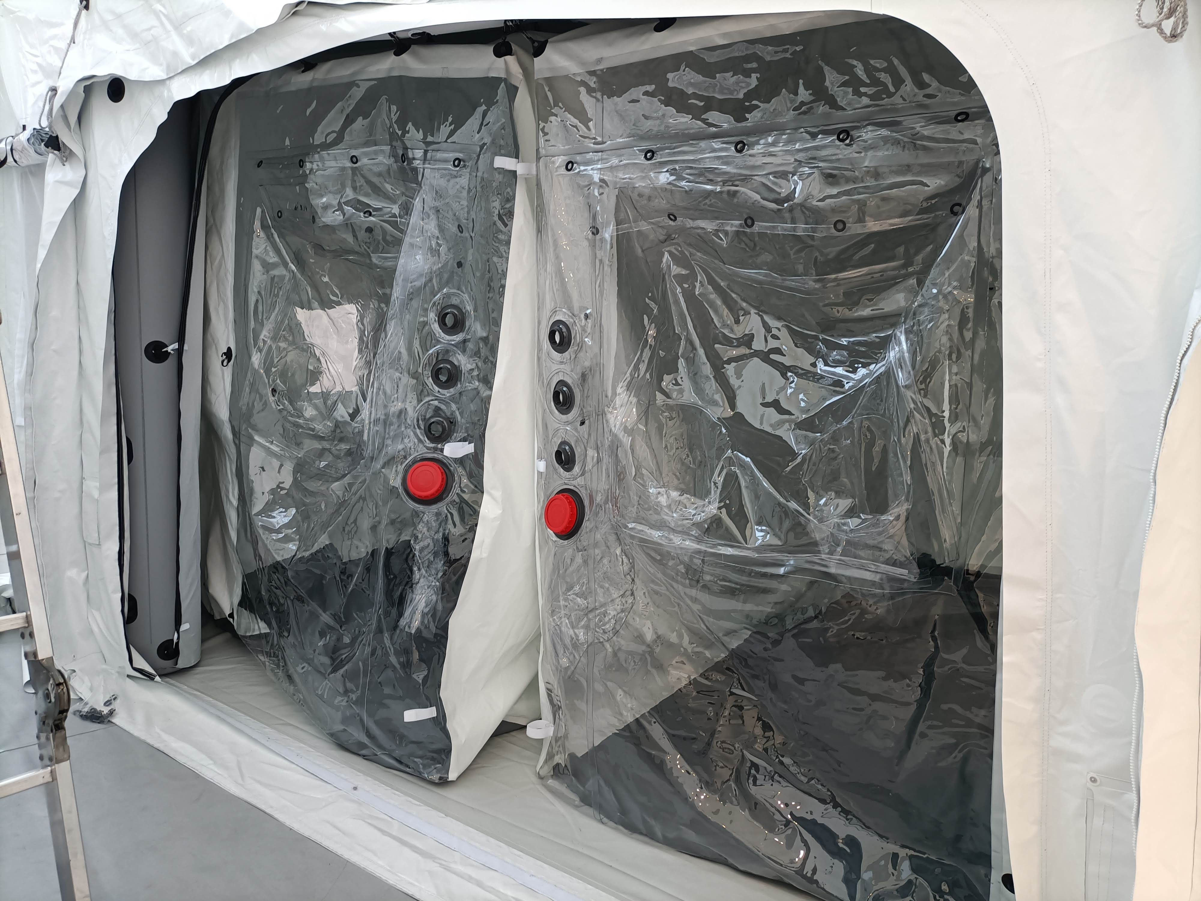
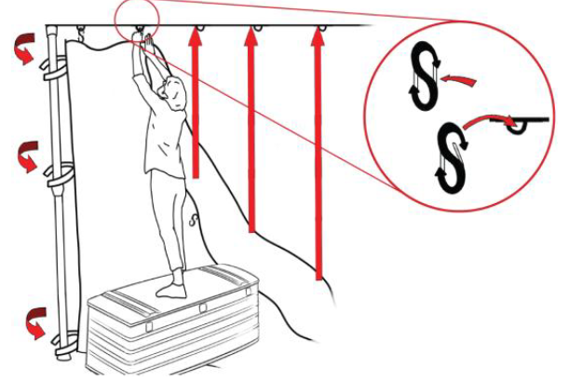
Step 8
Installation of the inner patient cabin:
Use the carabiners to connect the patient cabin to the inner liner previously installed
Start from the centre of the pod

Slide 12
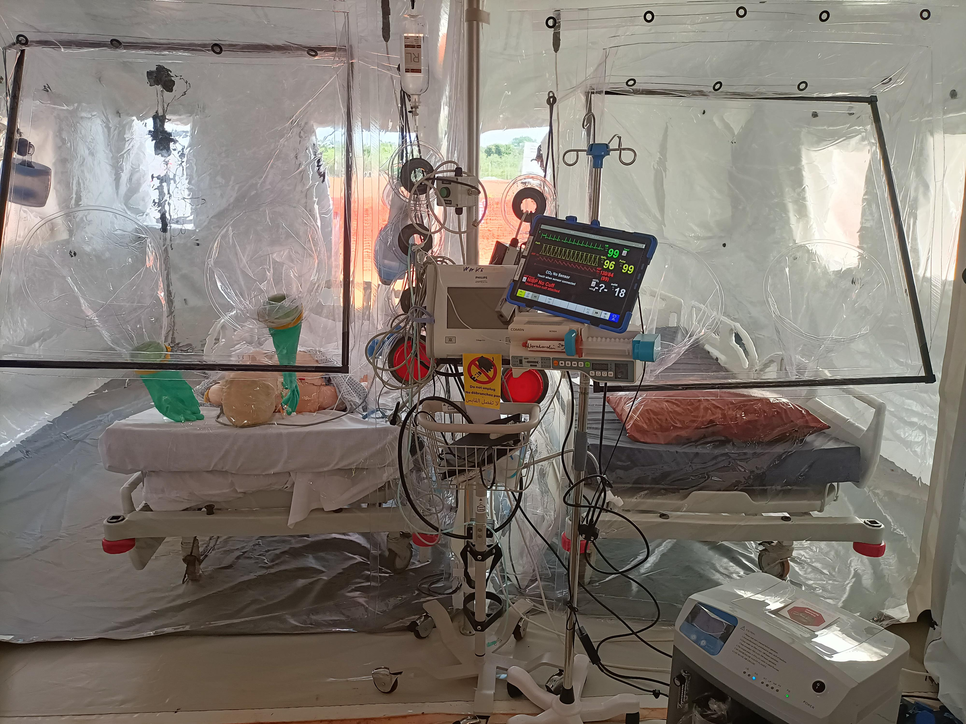
Step 9
Installation of the transparent screen:
Install the metallic poles and use the straps to fix the patient cabin to the pole
Install the black plastic frame to tension the screen
Install the gloves

Slide 13
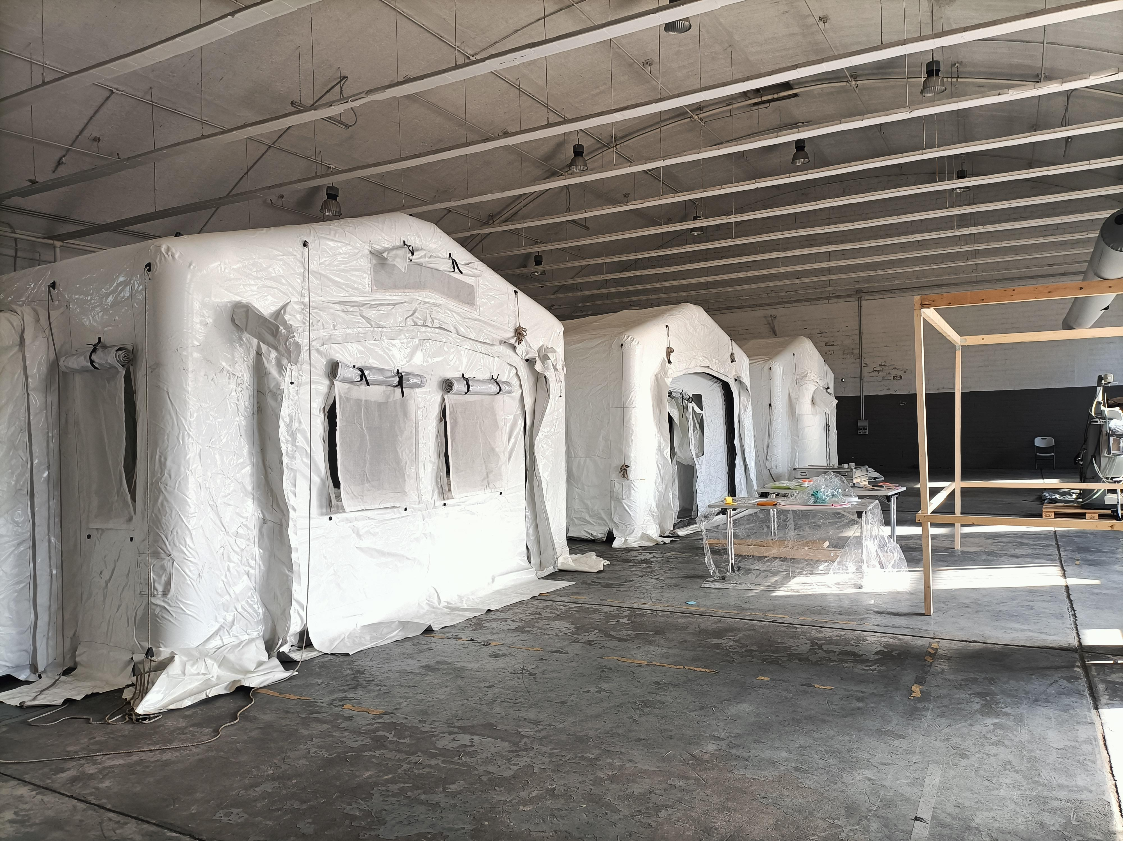
Step 10
Installation of the external panels:
Check the IDTM drawings and find the correspondent panels for every side of the pods ( 2 types: 2 windows, 2 sliding doors)
Install the panels using the zips
Connect the windows with the velcro

Slide 14
Thank you

